Slide 1


UNIVERSITY OF PADUA
UNIVERSITA’ DEGLI STUDI DI PADOVA
Designing an accessibility learning toolkit -
Bridging the gap between guidelines and implementation
Department of Mathematics “Tullio Levi-Civita”
Master Degree in Computer Science
Graduate: Gabriel Rovesti – ID: 2103389
Supervisor: Prof. Ombretta Gaggi
Graduation Session: 25/07/2025

Slide 2
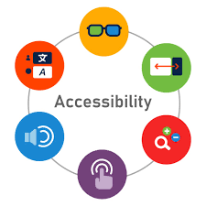

First and not least: Mobile accessibility
Definition: Ability for users to fully perceive, understand, navigate, and interact with digital content regardless of capabilities
The mobile reality:
1.3 billion people worldwide live with disabilities (WHO, 2023)
Mobile-first era: 6.8 billion smartphone users globally
Mobile interfaces create new accessibility barriers: small screens, orientation changes, performances impact
G. Rovesti - Designing an accessibility learning toolkit
2/16

Slide 3


First and not least: Mobile challenges
Touch interaction barriers:
Target size not standardized and difficult to use
Complex gestures might exclude different categories of users
One-handed operation limitations
Mobile context issues:
Small screens affect content hierarchy
Orientation changes disrupt navigation
Performance impact on battery and processing
G. Rovesti - Designing an accessibility learning toolkit
3/16

Slide 4
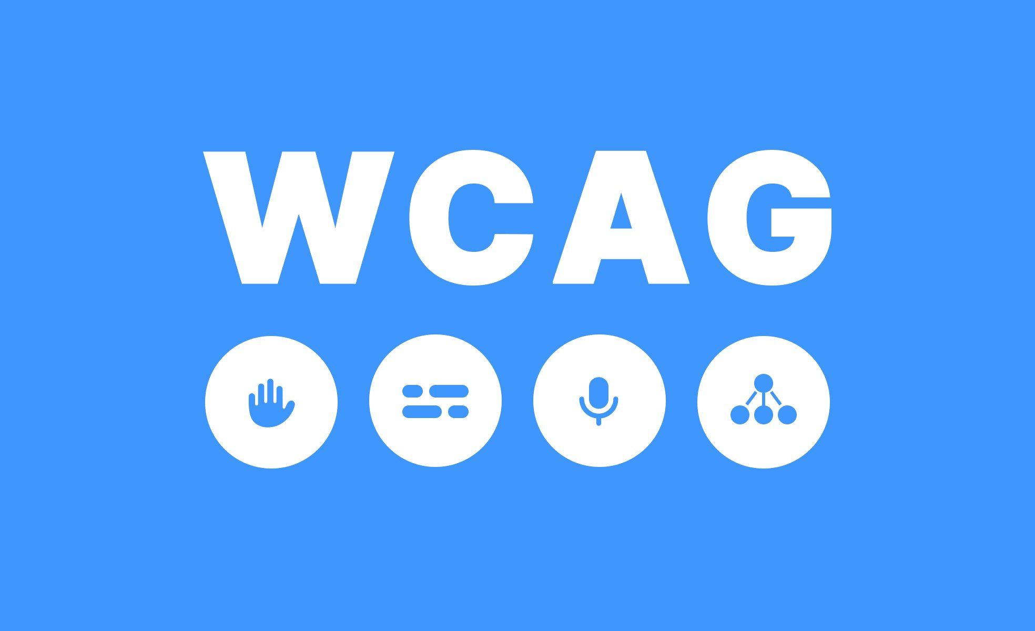

Accessibility guidelines gap
Current standards:
WCAG 2.2 (2023): 4 principles, 3 levels of conformance - web-focused
MCAG (2015): Mobile adaptation - based on WCAG 2.0
WCAG2Mobile (2025): Recent mobile guidance - interpretations only
The problem:
Outdated foundation: MCAG missing WCAG 2.1/2.2 mobile criteria
Implementation void: No practical framework for mobile developers
Knowledge fragmentation: Scattered resources, unclear costs
Result: Lack of comprehensive accessibility implementation, mostly web-focused
G. Rovesti - Designing an accessibility learning toolkit
4/16

Slide 5
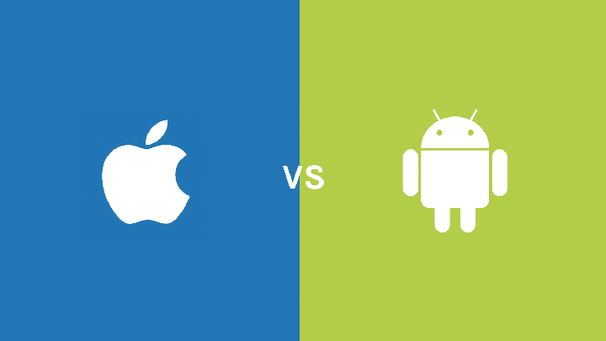
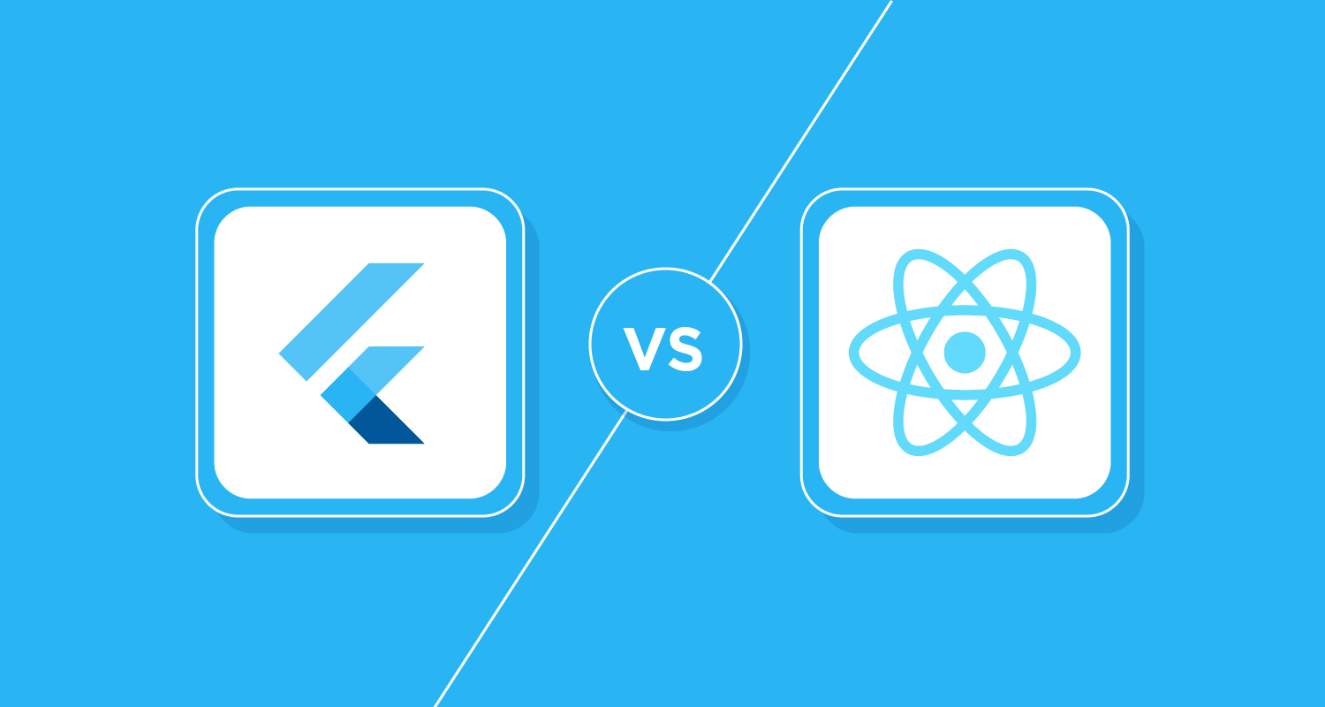
Platform implementation gap
Platform differences:
iOS: VoiceOver, Voice Control, Switch Control
Android: TalkBack, Switch Access
Framework responses:
Flutter: Single accessibility tree, platform adaptation layer
React Native: Platform-specific accessibility props, native bridge
The developer challenge:
Budai (2024): Tested component accessibility → fragmented knowledge
Gap identified: No comprehensive learning resource bridging platforms
G. Rovesti - Designing an accessibility learning toolkit
5/16

Slide 6
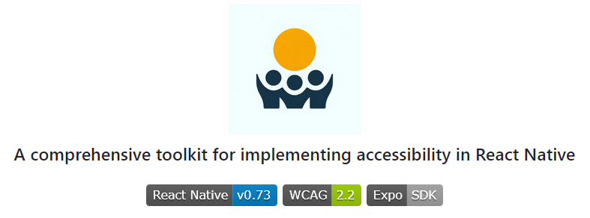
AccessibleHub – Bridging the gap
Research Questions as standard approach:
RQ1: Are React Native components accessible by default?
RQ2: Can non-accessible components be made accessible?
RQ3: What's the implementation cost (code overhead)?
AccessibleHub: React Native application tested on both Android and iOS serving as interactive accessibility manual for mobile developers
Every screen analyzed for accessibility patterns and costs
Developer-first educational platform bridging theory to practice
G. Rovesti - Designing an accessibility learning toolkit
6/16

Slide 7


AccessibleHub – Overview
Core sections:
🔧 Accessible Components: UI implementations with copyable code
📚 Best Practices: Educational content on accessibility challenges
🛠️ Tools - Settings: Resource catalog for testing and common settings
📊 Framework Comparison: Evidence-based evaluation methodology
👥 Instruction & Community: Social learning & collaborative resources
Research innovation: Every screen analyzed as case study
- Dual methodology: Both research vehicle & educational tool
- 20+ components tested with TalkBack and VoiceOver
- Cross-platform validation ensuring patterns work universally
G. Rovesti - Designing an accessibility learning toolkit
7/16

Slide 8
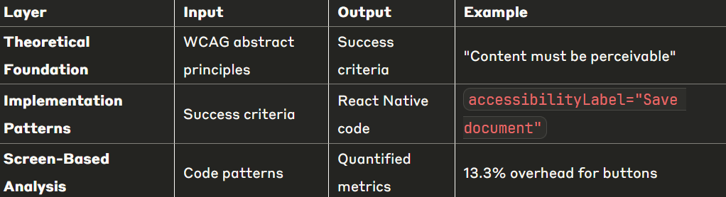
Systematic analysis approach
The transformation challenge: WCAG guidelines are abstract and difficult to implement directly in mobile code
Basic workflow - Enabling data-driven accessibility decisions
Abstract WCAG → Implementation Patterns →
Quantified Metrics → Educational Platform
G. Rovesti - Designing an accessibility learning toolkit
8/16

Slide 9
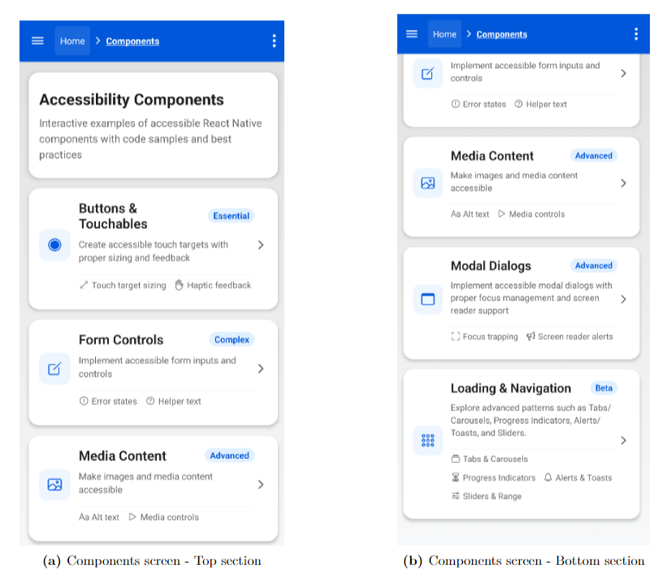
Systematic analysis – Example (1)
G. Rovesti - Designing an accessibility learning toolkit
9/16

Slide 10
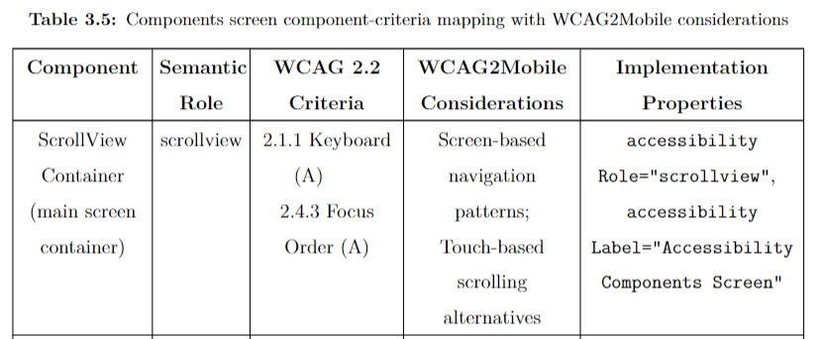
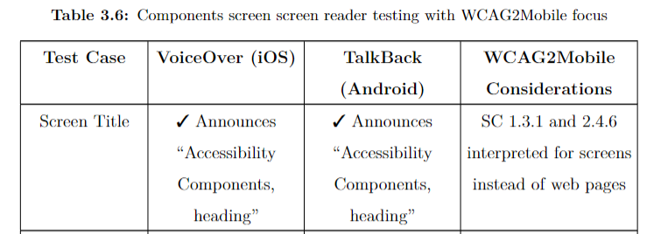
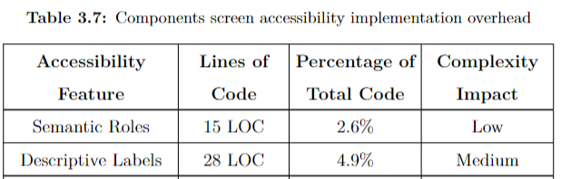
Systematic analysis – Example (2)
G. Rovesti - Designing an accessibility learning toolkit
10/16

Slide 11
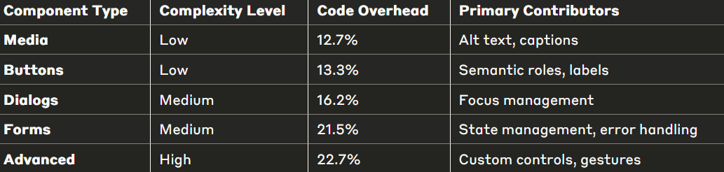
Accessibility implementation costs
Key finding: Accessibility implementation requires 12-23% additional code across component types
Critical insights:
Even complex components stay under 25%
Correlation between interaction complexity and implementation cost
Manageable overhead for significant usability improvements
First quantitative framework for mobile accessibility cost assessment
G. Rovesti - Designing an accessibility learning toolkit
11/16

Slide 12

Formal evaluation metrics
Innovation: Evidence-based methodology for quantifying mobile accessibility implementation across frameworks
🔢 Implementation Overhead (IMO)
Direct code cost measurement for equivalent functionality
📱 Screen Reader Support Score (SRSS):
Likert scale based on VoiceOver/TalkBack functionality
✅ WCAG Compliance Ratio (WCR):
Standards adherence tracking (A/AA/AAA levels)
⚙️ Complexity Impact Factor (CIF):
Development difficulty classification (Low/Medium/High)
⏱️ Development Time Estimate (DTE):
Resource planning with complexity adjustments
G. Rovesti - Designing an accessibility learning toolkit
12/16

Slide 13
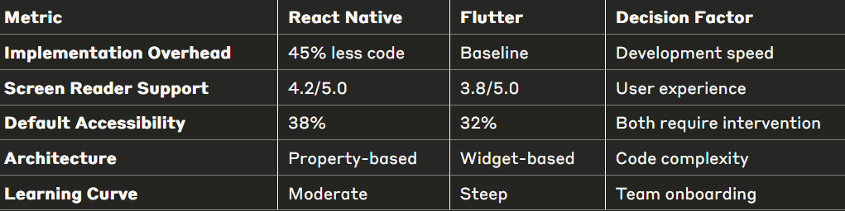
Framework comparison
Architecture differences:
React Native: Property-based model (accessibilityLabel, accessibilityRole)
Flutter: Widget-based approach (explicit Semantics wrappers)
G. Rovesti - Designing an accessibility learning toolkit
13/16

Slide 14
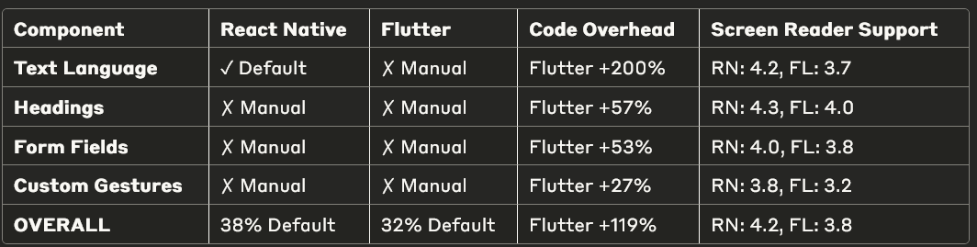
Framework comparison results (1)
Key Patterns Identified:
Text language declaration: Largest overhead difference (Flutter +200%)
Custom gestures: Smallest gap (Flutter +27%) - both frameworks struggle
Default accessibility: React Native provides more out-of-box features (38% vs 32%)
Screen reader consistency: React Native scores higher across all component types
G. Rovesti - Designing an accessibility learning toolkit
14/16

Slide 15
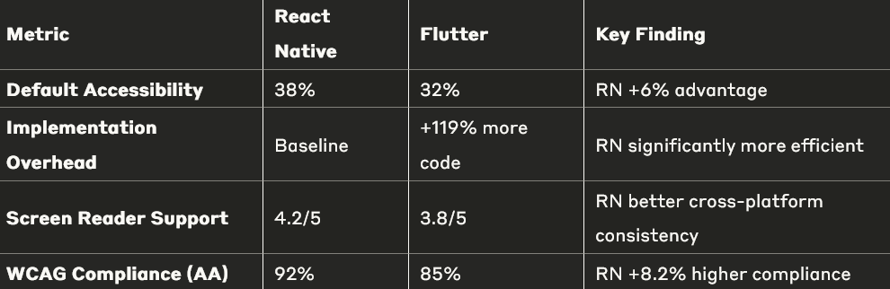
Framework comparison results (2)
Insights for development choice:
React Native for: Rapid development, web accessibility knowledge, tight deadlines
Flutter for: Complex custom components, long-term maintenance teams, granular control
G. Rovesti - Designing an accessibility learning toolkit
15/16

Slide 16


Research impact and conclusions
Key contributions:
Extended research framework from Flutter-only to comparative analysis
First quantitative framework for mobile accessibility cost assessment
Systematic methodology bridging WCAG theory to mobile practice
Research answers:
RQ1: No framework accessible by default (38% vs 32%)
RQ2: Both achieve 85-90% WCAG compliance with proper implementation
RQ3: React Native requires 45% less code for equivalent accessibility
G. Rovesti - Designing an accessibility learning toolkit
16/16

